Slide 1
Ceis150 programming with objects
By Kevin Foxen

Slide 2
Introduction
In this course, we developed a program to display statistics for stocks such as Tesla and Ford Motor Company. This program utilizes advanced concepts in object-oriented programming such as classes, inheritance, libraries, functional programming, iterators, generators, web scraping, and GUIs. At the beginning of the project, we had to enter the information requested by the program within the text base code. In the end, we incorporated libraries such as CSV, matplotlib, and Tkinter to create GUI functions that transformed the program into a reactive program.

Slide 3
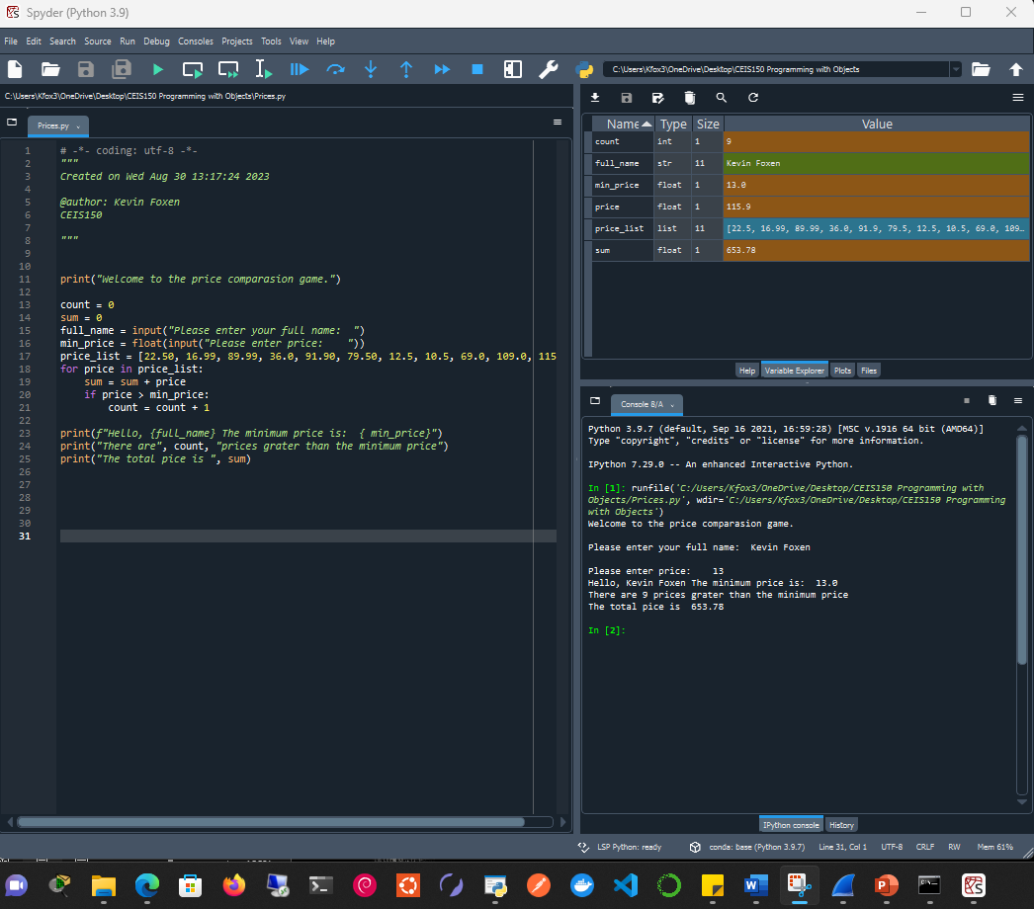
Program
This screenshot shows that this Anaconda IDE was set up successfully and ready. I would later change my IDE over to VS Code

Slide 4
Class Diagrams Class Coding Unit Testing

Slide 5
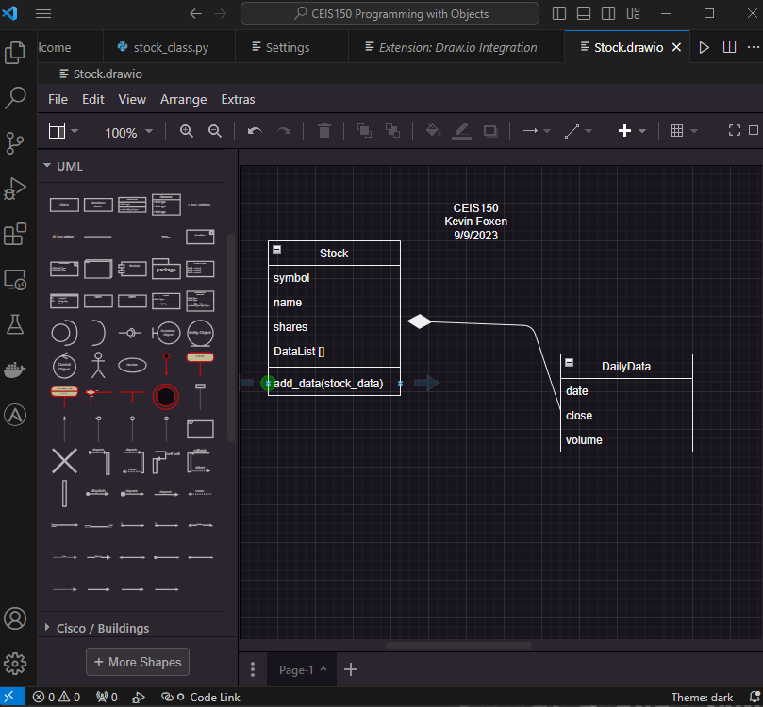
Class Diagram
This screenshot displays the process of creating a class diagram in VS Code using the draw.io program.

Slide 6
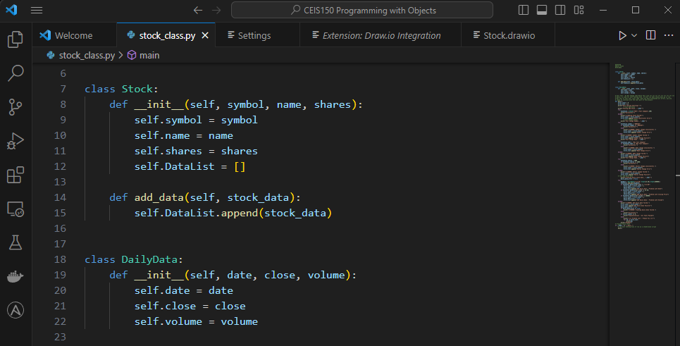
Class Code
This screenshot shows the code that was written based on the previous class diagram.

Slide 7
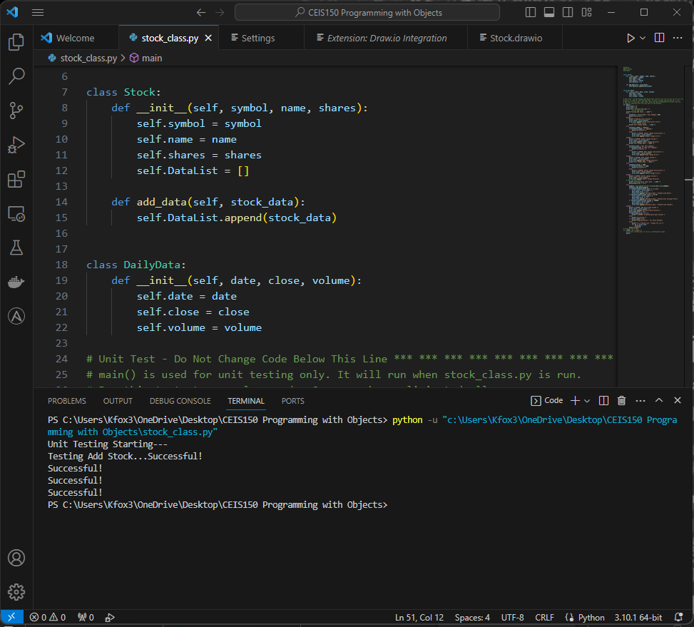
Unit Test
This screenshot shows the code completed the unit test successfully.

Slide 8
Text-Based User Interface Summary Report

Slide 9
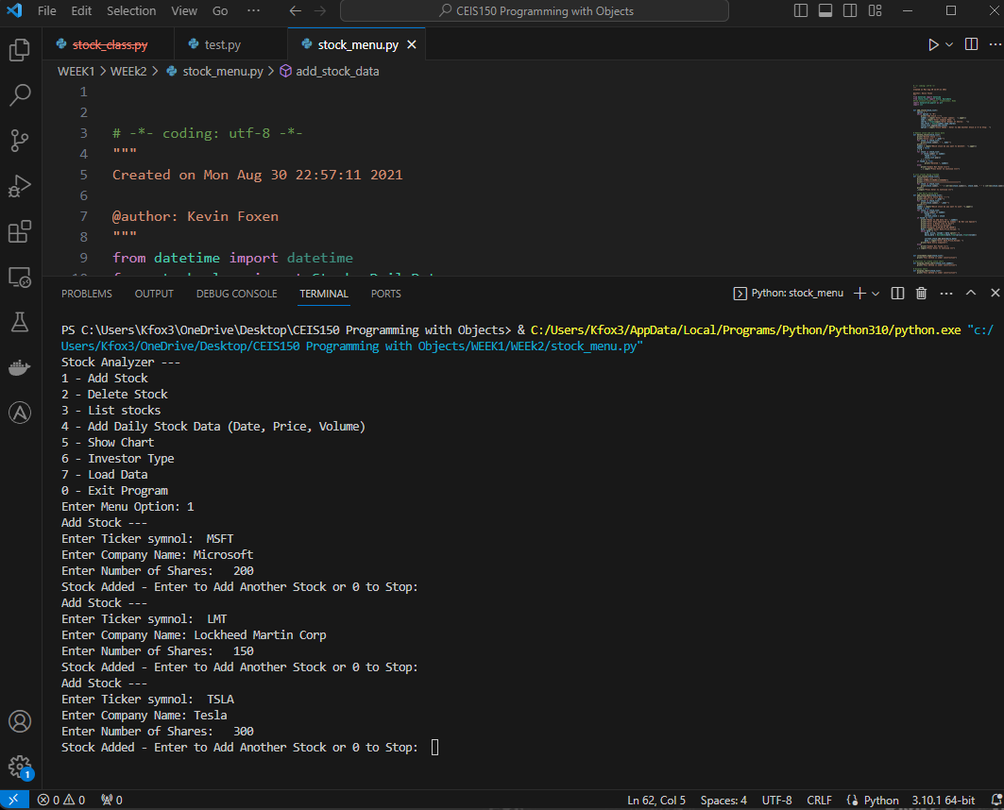
Adding a Stock
This screenshot displays three manually entered stocks in the stock_menu.py file: Microsoft, Lockheed Martin Corp, and Tesla, along with their respective ticker symbols and shares.

Slide 10
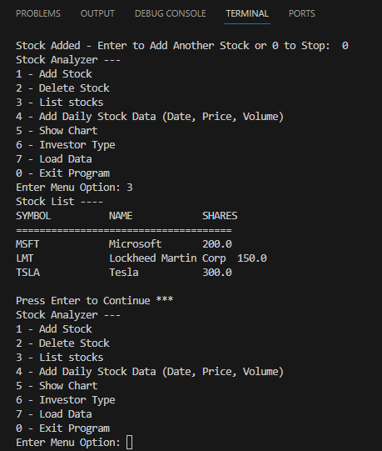
Listing 3 Stocks
This screenshot displays manually entered stocks listed under option 3 - List stock code.

Slide 11
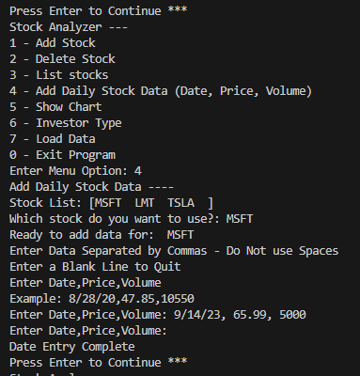
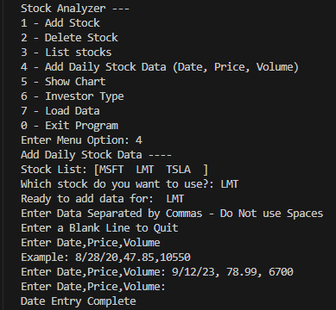
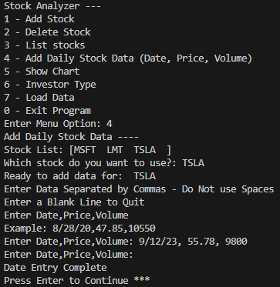
Daily Data
This screenshot displays additional manually entered stock information such as date, price, and volume listed using option 4 – Add daily stock data.

Slide 12
Inheritance Summary Report

Slide 13
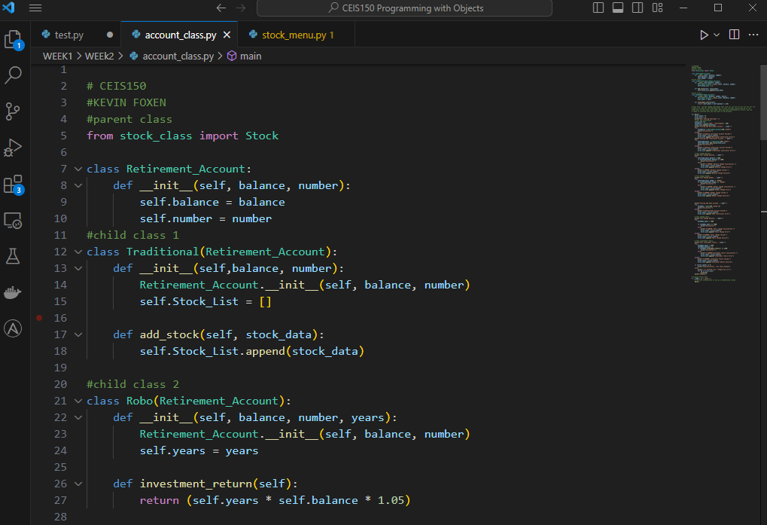
Inherited classes
This screenshot shows three classes created for the program to inherit from.

Slide 14
Unit Tests
This screenshot shows the successful unit test of the created class.

Slide 15
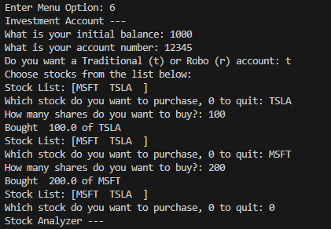
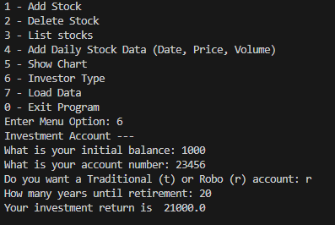
Stock menu program
This screenshot shows the program working correctly with text-based input.

Slide 16
Creating a chart

Slide 17
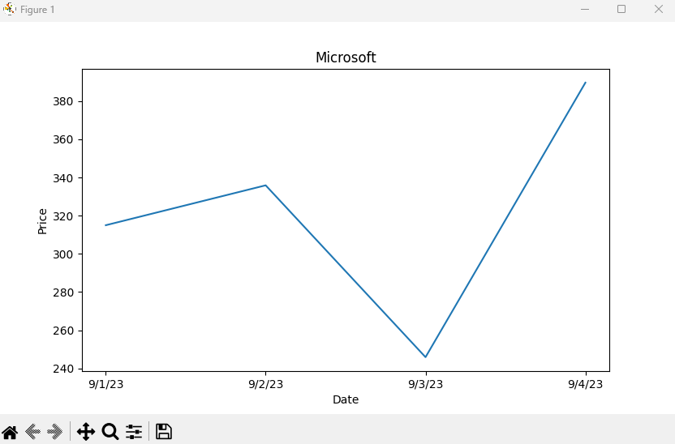
Chart
This screenshot shows the incorporation of the pyplot class from the matplotlib library to create a chart that shows Microsoft stock prices over time.

Slide 18
Loading data

Slide 19
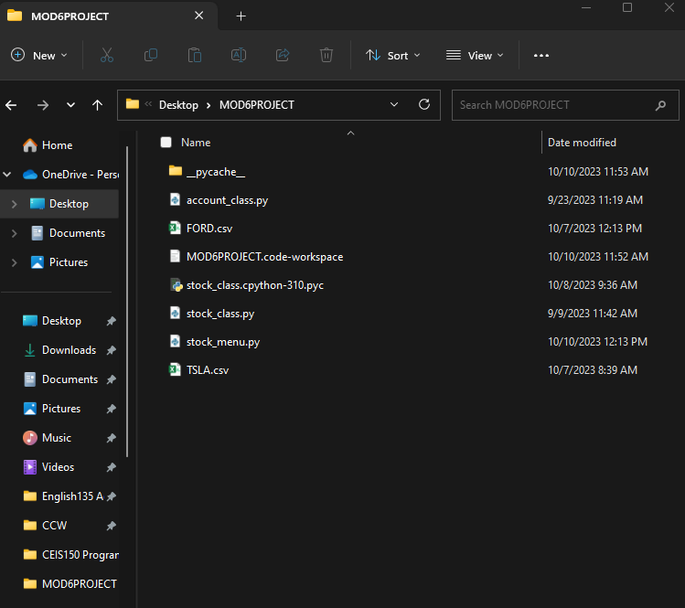
File
This screenshot shows Ford and tesla.csv stock Excel files downloaded from Yahoo finance. Which will be incorporated into the stock program.

Slide 20
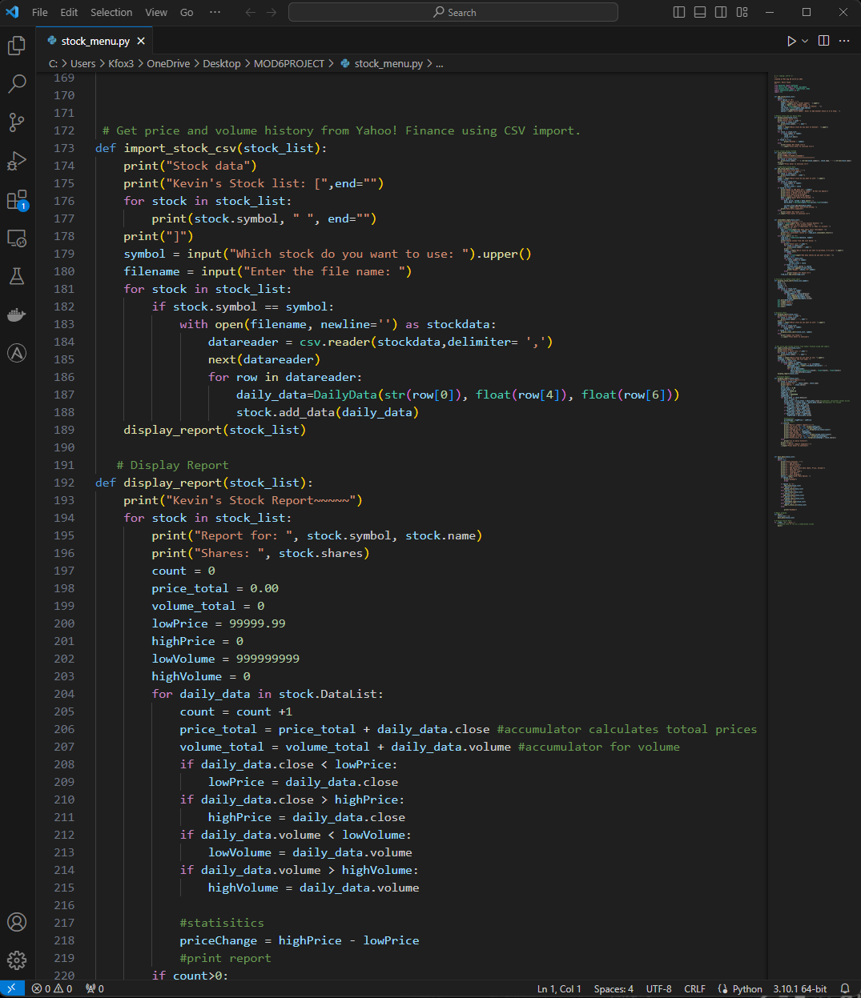
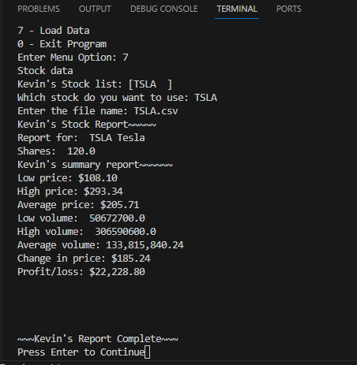
Importing data
This screenshot shows the importation of the TESLA Tesla.csv file and the code to execute it.

Slide 21
gui

Slide 22
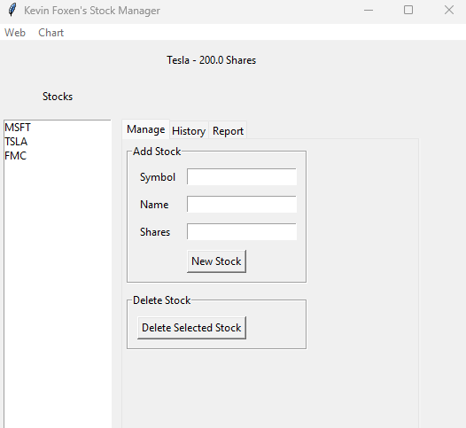
Stocks in GUI
This screenshot shows the incorporation of the tkinter package in order to create a reactive gui interface that takes user input.

Slide 23
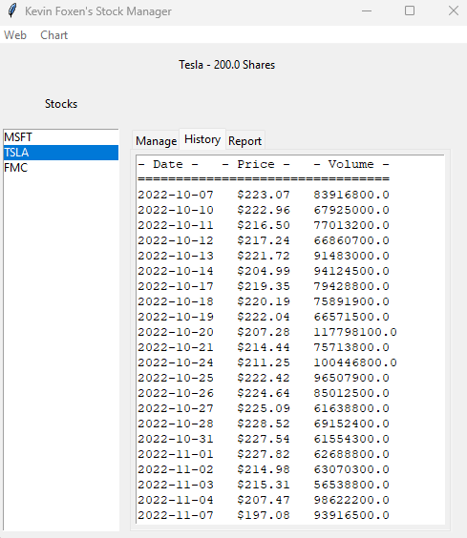
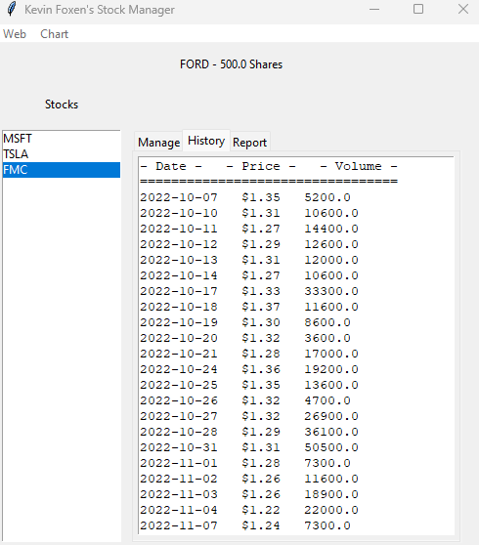
History Tab
This screenshot shows the data that was web scraped from yahoo finance once the stock ticker information was entered.

Slide 24
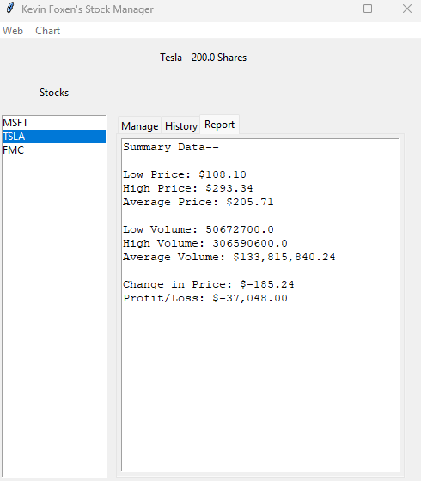
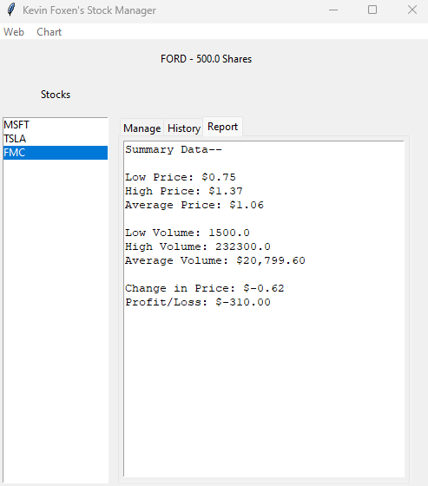
Report Complete
This screenshot shows the high and low prices as well as volume for the selected stocks tesla, ford, and entered shares.

Slide 25
Challenges and career skills
This course and project proved to be quite challenging and required a massive amount of attention to detail. I was able to complete the majority of the project without any errors until we incorporated .csv files. When writing that part of the program I had misspelled a simple word that cost me several days of headache while scanning the code and libraries. I was able to resolve the issue and learned that attention to detail is an important part of writing large sections of code.
This setback was an invaluable learning experience that helped create and hone practical career expertise. Skills such as systematic analysis, unit testing, and determination are some of the key skills that were required to resolve the issue.

Slide 26
Conclusion
In conclusion, this course was designed to test students' abilities and current understanding of important programming subject matter. Topics such as OOP, classes, inheritance, storage, functional programming, Web scraping, and Gui’s were the primary areas we focused on when writing our code. I thought that the course project was a lot of fun and provided a realistic example of what Developers go through on a daily basis. This project has improved my current coding skill set immensely and has inspired me to continue to learn more about programming.

