Slide 1
SEC285
Fundamentals of information system security
By Kevin Foxen

Slide 2
INTRODUCTION
This course covered a wide range of security principles such as the CIA triad and its practical application which is demonstrated through our projects. We performed file encryption services, used network mapping tools such as NMAP, and even set up multifactor authentication using Ubuntu and google authenticator.

Slide 3
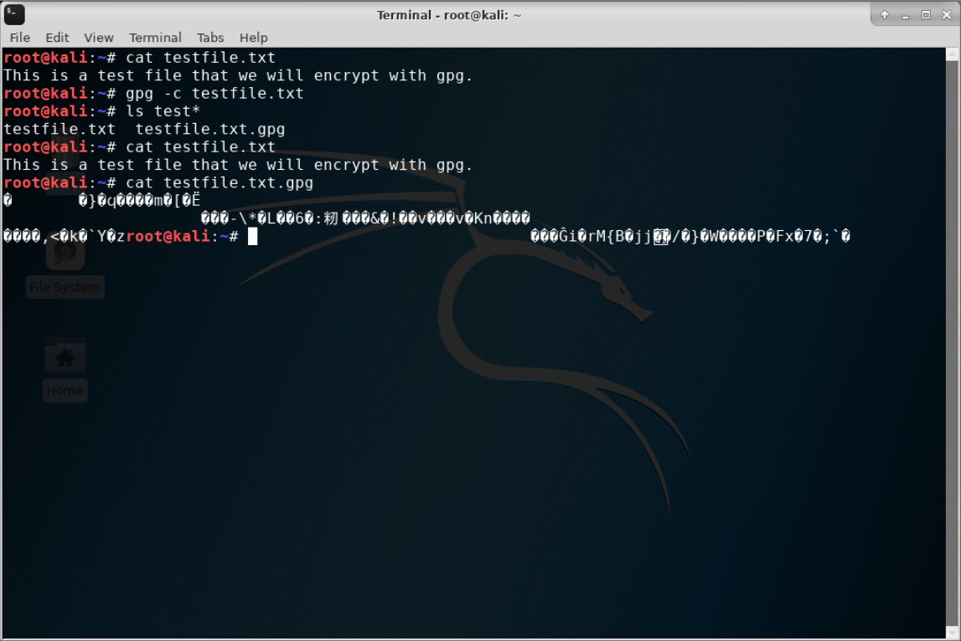
File Encryption
This screenshot shows the :
Content of the plaintext file
Content of the encrypted file

Slide 4
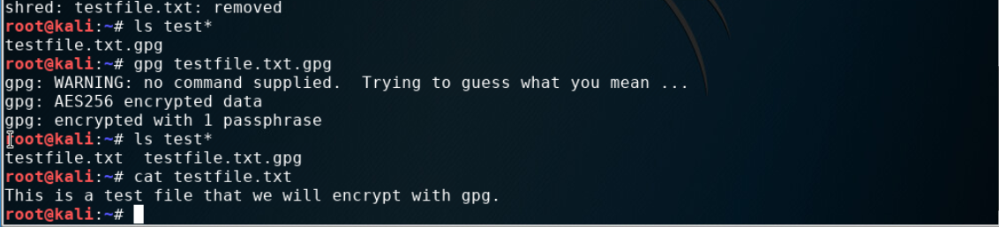
File Decryption
This screenshot shows the :
The encrypted file being listed by itself
The decrypting process
Both the encrypted file and the original plaintext file are listed

Slide 5
Stateful Firewall
In this lab, we used Kali Linux to secure the Metasploit Linux server by creating a stateful firewall using iptables. Using Nmap and the server’s IP address on the Kali Linux machine we were able to see what ports were open on the server.

Slide 6
Question
What effect does the sudo iptables --policy INPUT DROP command have on the access to computing resources?
Answer here:
The Nmap scan originally displayed all open ports on the Linux server. When the INPUT DROP was entered and the second Nmap scan was performed the output did not show open ports which indicates that the packets were dropped at the server.

Slide 7
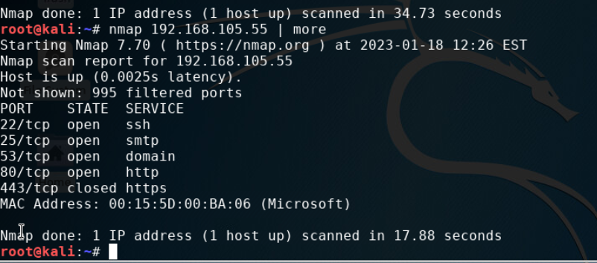
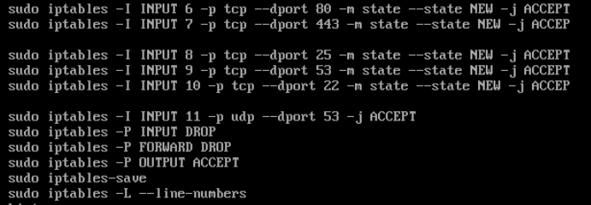
Nmap Scan
This screenshot shows the Nmap scan result of the Linux Server VM.

Slide 8
BYOD/AUP POLICY
The idea behind this project was to create a BYOD POLICY that we thought would work for a fictitious company.

Slide 9
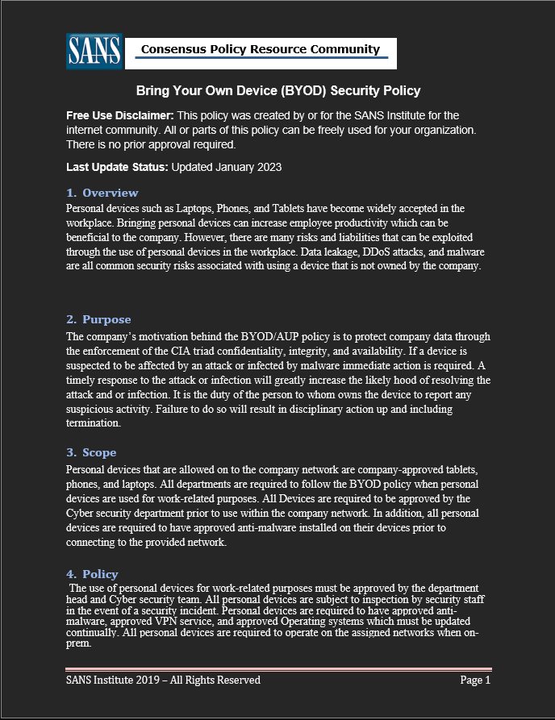
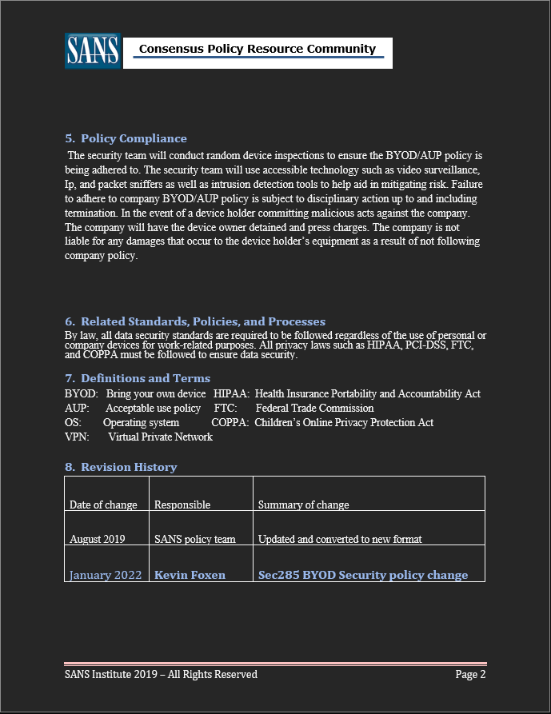
BYOD/AUP policy

Slide 10
Multifactor Authentication (MFA)
We created a multifactor authentication that uses the Ubuntu Linux distro and Google Authenticator. After configuring a new user and google authenticator in the Linux distro you then can use the google authenticator to read the generated QR code to develop a random key to use with the login screen.

Slide 11
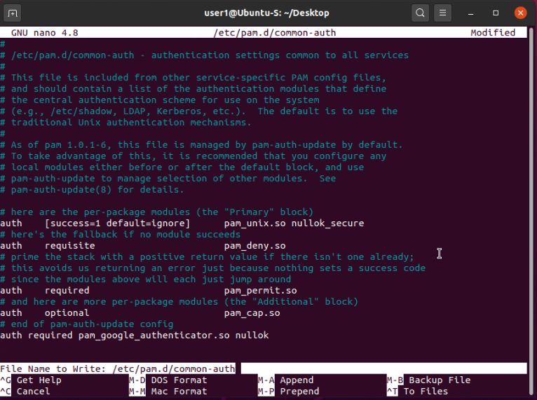
Common-auth Configuration File
This screenshot should show the entry that indicates the use of the Google Authenticator module.

Slide 12
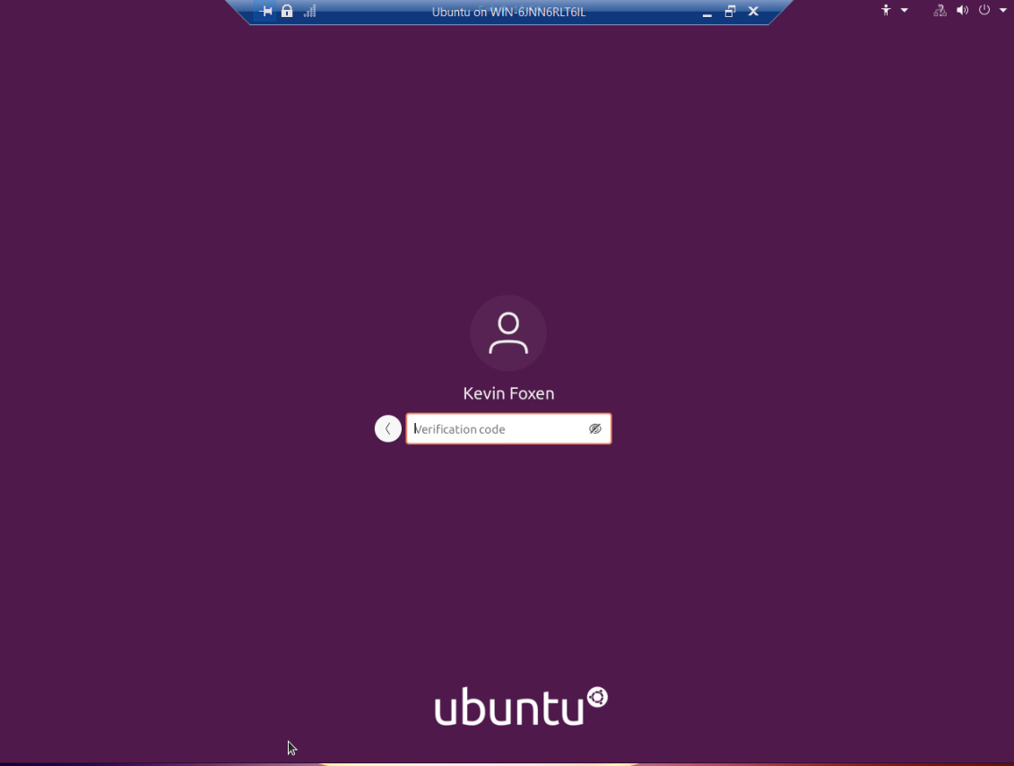
MFA Logon Screen
This screenshot shows the logon screen where a verification code is required.

Slide 13
Vulnerability Assessment
In this module, we used three different vulnerability tools Nmap, Ncat, and Nesssus to display vulnerabilities on a metasploitable2 server. Using Nmap we were able to determine what ports were open on the Linux server. We used Wireshark to uncover a weak password that was set up in the server for an SSH connection.

Slide 14
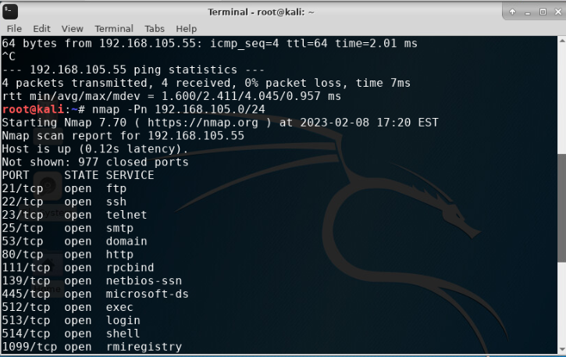
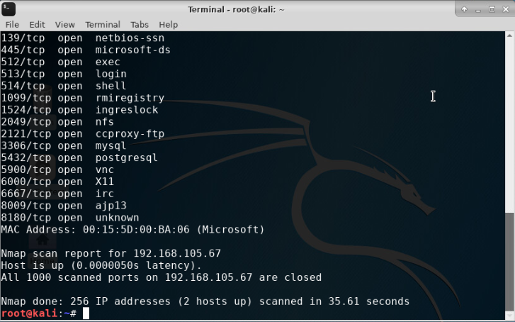
Nmap
This screenshot includes the scan result showing both the Kali Linux and the Linux Server VMs.

Slide 15
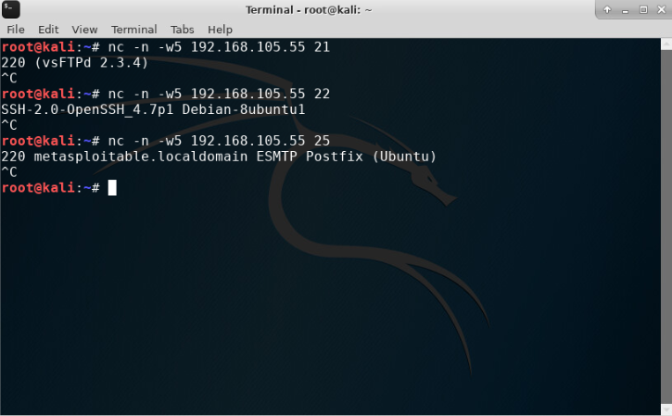
NetCat
This screenshot shows the scan result of both the Kali and Linux Server VMs.

Slide 16
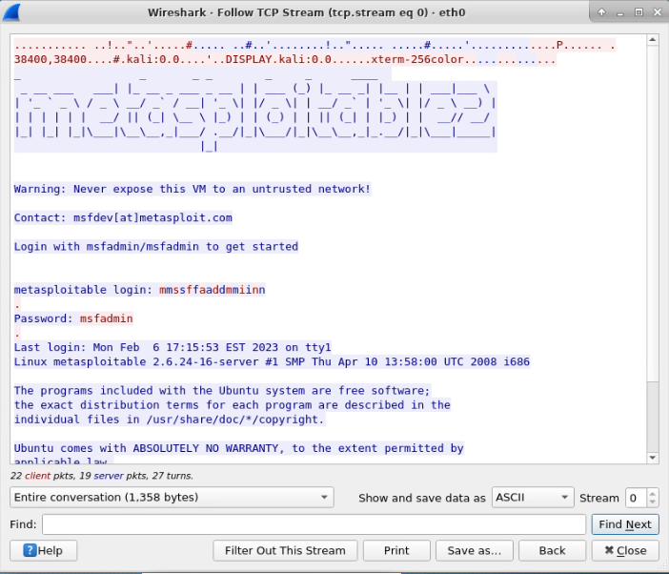
Wireshark
This screenshot shows the Wireshark—Follow TCP Steam window showing the Telnet username and password.

Slide 17
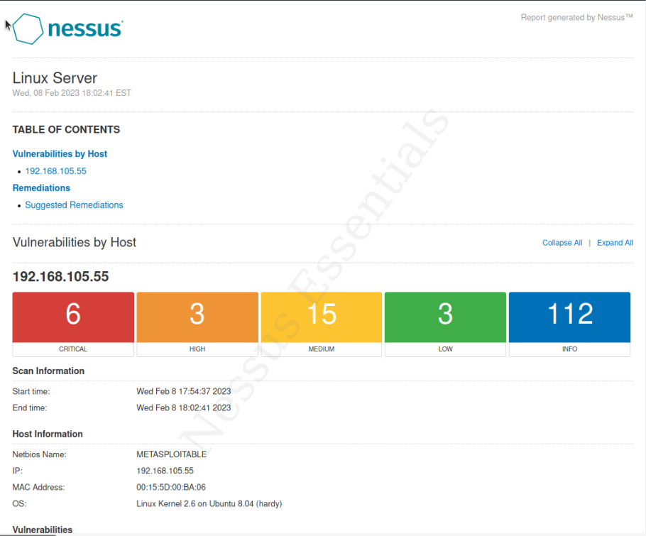
Nessus
This screenshot shows a high-level view of the Nessus vulnerability scan report (showing categories of vulnerability in different colors).

Slide 18
CAEREER SKILLS & CHALLENGES
Throughout the course of this class, we continued to build important critical thinking, problem solving, and troubleshooting skills. I think that the biggest challenge that I faced was not the course projects them selves, but what seemed like an endless number of acronyms used in the information security field. Knowing what the acronyms meanings were important to understanding the theory behind the technology. The projects we preformed were detailed and had very clear and detailed instructions.

Slide 19
CONCLUSION
This course does a good job of introducing the fundamentals of information security processes. We covered a wide range of theory ranging topics such as encryption, and authentication services like RADIUS. The course projects helped solidify the theory and put the concepts into practice hands on interaction and repetition. The cryptography, multi factor authentication, exposing clear text passwords were very detailed projects that provided a sense of real-world expectations.

Slide 20
References:
Ciampa, M. D., & Computing Technology Industry Association. (2018). CompTIA security+ guide to network security fundamentals (6th ed.). Boston [Mass.] Cengage Learning.\
Conklin, W. A., & White, G. (2021). CompTIA Security+ all-in-One exam guide (Exam SY0-601)) (6th ed.). McGraw Hill Professional.

